Slide 1
Artificial Intelligence CS-202
Topic: Natural Language Processing (NLP)
Habiba Arshad
Department of Computer Science
University of Wah

Slide 2
Week-12 CLO’s
This week lecture will cover the following CLO’s:
CLO1: Discuss the key concepts in the field of artificial intelligence
CLO 2: Implement artificial intelligence techniques and case studies
CLO 3: Model an automated solution for given problems using artificial intelligence paradigm.

Slide 3
Natural Language processing (NLP)

Slide 4
Natural Language Processing (NLP)
Natural language processing (NLP) is the ability of a computer program to understand human language as it's spoken and written -- referred to as natural language. It's a component of artificial intelligence (AI).
Key Tasks
Language translation (e.g., Google Translate).
Sentiment analysis (e.g., analysing tweets or reviews).
Chatbots (e.g., customer support bots).

Slide 5
Components of NLP

Slide 6
Components of NLP
Natural Language Processing is not a monolithic, singular approach, but rather, it is composed of several components, each contributing to the overall understanding of language. The main components that NLP strives to understand are:
Syntax
Semantics
Pragmatics
Discourse.

Slide 7
Components of NLP
Syntax
Definition: Syntax pertains to the arrangement of words and phrases to create well-structured sentences in a language.
Example:
Consider the sentence "The cat sat on the mat."
Syntax involves analyzing the grammatical structure of this sentence, ensuring that it adheres to the grammatical rules of English, such as subject-verb agreement and proper word order.

Slide 8
Components of NLP
Semantics
Definition: Semantics is concerned with understanding the meaning of words and how they create meaning when combined in sentences.
Example:
In the sentence "The panda eats shoots and leaves," semantics helps distinguish whether the panda eats plants (shoots and leaves) or is involved in a violent act (shoots) and then departs (leaves), based on the meaning of the words and the context.

Slide 9

Syntax and Semantics in NLP
Example:
Syntax: "Colorless green ideas sleep furiously" (correct grammar but meaningless semantics).
Semantics: "I love programming" (meaningful).

Slide 10
Components of NLP
Pragmatics
Definition: Pragmatics deals with understanding language in various contexts, ensuring that the intended meaning is derived based on the situation, speaker’s intent, and shared knowledge.
Example:
If someone says, "Can you pass the salt?"
Pragmatics involves understanding that this is a request rather than a question about one's ability to pass the salt, interpreting the speaker’s intent based on the dining context.

Slide 11
Components of NLP
Discourse:
Definition: Discourse focuses on the analysis and interpretation of language beyond the sentence level, considering how sentences relate to each other in texts and conversations.
Example:
In a conversation where one person says, "I’m freezing," and another responds, "I’ll close the window," discourse involves understanding the coherence between the two statements, recognizing that the second statement is a response to the implied request in the first.

Slide 12
NLP Applications

Slide 13
NLP Applications and Techniques
NLP enables machines to understand, interpret, and generate human language.
Core Applications:
Extracting structured information from text.
Analysing opinions and emotions.
Identifying grammar components.

Slide 14
NLP Techniques and Methods

Slide 15
NLP Techniques and Methods
To analyze and understand human language, NLP employs a variety of techniques and methods. Here are some fundamental techniques used in NLP:
Tokenization. This is the process of breaking text into words, phrases, symbols, or other meaningful elements, known as tokens.
Parsing. Parsing involves analyzing the grammatical structure of a sentence to extract meaning.

Slide 16
Text Processing and Preprocessing
Types of Tokenization
Tokenization can be classified into several types based on how the text is segmented. Here are some types of tokenization:
Word Tokenization:
Word tokenization divides the text into individual words. Many NLP tasks use this approach, in which words are treated as the basic units of meaning.
Example:
Input: "Tokenization is an important NLP task."
Output: ["Tokenization", "is", "an", "important", "NLP", "task", "."]

Slide 17
Text Processing and Preprocessing
Types of Tokenization
Sentence Tokenization:
The text is segmented into sentences during sentence tokenization. This is useful for tasks requiring individual sentence analysis or processing.
Example:
Input: "Tokenization is an important NLP task. It helps break down text into smaller units."
Output: ["Tokenization is an important NLP task.", "It helps break down text into smaller units."]

Slide 18
Text Processing and Preprocessing
Types of Tokenization
Subword Tokenization:
Subword tokenization entails breaking down words into smaller units, which can be especially useful when dealing with morphologically rich languages or rare words.
Example:
Input: "tokenization"
Output: ["token", "ization"]

Slide 19
Text Processing and Preprocessing
Types of Tokenization
Character Tokenization:
This process divides the text into individual characters. This can be useful for modelling character-level language.
Example:
Input: "Tokenization"
Output: ["T", "o", "k", "e", "n", "i", "z", "a", "t", "i", "o", "n"]

Slide 20
Techniques used for Tokenization
NLTK Library
Spacy
BERT tokenizer
Byte-Pair Encoding
Sentence Piece

Slide 21
Limitations of Tokenization
Tokenization is unable to capture the meaning of the sentence hence, results in ambiguity.
In certain languages like Chinese, Japanese, Arabic, lack distinct spaces between words. Hence, there is an absence of clear boundaries that complicates the process of tokenization.
Text may also include more than one word, for example email address, URLs and special symbols, hence it is difficult to decide how to tokenize such elements.

Slide 22
Stemming and Lemmatization
Stemming and lemmatization are both text normalization techniques used in Natural Language Processing (NLP) to reduce words to their base or root form. This helps in treating related words (e.g., "run", "running", "runs") as the same in tasks like search, classification, or analysis.

Slide 23
Stemming
Stemming is the process of chopping off the end of words to get to their root form (which may not be a real word).
It uses simple, rule-based heuristics (not always grammatically correct).
Fast and simple. Useful when perfect accuracy is not necessary (e.g. search engines)
Can produce non-words
Less accurate than lemmatization

Slide 24
Stemming
Example:
Original Word | Stemmed Word
running | run
happily | happi
studies | studi
organization | organ

Slide 25
Lemmatization
This technique reduces words to their base or root form, allowing for the grouping of different forms of the same word.
It considers context, grammar, and word meaning. Requires a dictionary or corpus.
More accurate and meaningful. Produce real dictionary words
Slower and complex as it requires more resources.
Use lemmatization when meaning matters, like in machine translation, chatbots, or sentiment analysis.

Slide 26
Lemmatization
Example:
Original Word | Lemma
running | run
studies | study
better | good
was | be

Slide 27
Stop word removal
In natural language processing (NLP), stopwords are frequently filtered out to enhance text analysis and computational efficiency.
Certain words, like "the," "and," and "is," are thought to be ineffective for communicating important information.
The goal of removing stopwords is to speed up text processing by eliminating words that do not add much meaning, even though the set of stopwords can vary.

Slide 28
Types of Stop Words
Common Stopwords: These are the most frequently occurring words in a language and are often removed during text preprocessing. Examples include "the," "is," "in," "for," "where," "when," "to," "at," etc.
Custom Stopwords: Depending on the specific task or domain, additional words may be considered as stopwords. These could be domain-specific terms that don't contribute much to the overall meaning. For example, in a medical context, words like "patient" or "treatment" might be considered as custom stopwords.

Slide 29
Types of Stop Words
Numerical Stopwords: Numbers and numeric characters may be treated as stopwords in certain cases, especially when the analysis is focused on the meaning of the text rather than specific numerical values.
Single-Character Stopwords: Single characters, such as "a," "I," "s," or "x," may be considered stopwords, particularly in cases where they don't convey much meaning on their own.
Contextual Stopwords: Words that are stopwords in one context but meaningful in another may be considered as contextual stopwords. For instance, the word "will" might be a stopword in the context of general language processing but could be important in predicting future events.

Slide 30
Text Normalization
Text normalization is a crucial preprocessing step in NLP that transforms raw text into a standard, consistent format to improve the performance of downstream tasks like sentiment analysis, translation, or text classification.

Slide 31
Technique | Purpose | Example
Lowercasing | Removes case sensitivity | Hello → hello
Removing punctuation | Cleans text of non-essential symbols | hello! → hello
Removing stop words | Removes frequent, low-meaning words | is, the, an, in → removed
Stemming | Cuts word to root form (may not be valid word) | running → run / runn
Lemmatization | Converts word to base dictionary form | better → good, studies → study
Expanding contractions | Converts short forms to full forms | can't → cannot
Spell correction | Fixes typos and errors | speling → spelling
Removing numbers/symbols | Cleans up unwanted characters | I have 3 cats → I have cats
Tokenization | Splits text into individual words or sentences | "I love NLP" → ["I", "love", "NLP"]

Slide 32
Example
Text:
"I'm LOVING Natural-Language Processing“
After Normalization:
i am loving natural language processing

Slide 33
Syntax and Parsing

Slide 34
Syntax and Parsing
Part-of-Speech (POS) Tagging: Assigning parts of speech to each word in a sentence (e.g., noun, verb, adjective).
Dependency Parsing: Analyzing the grammatical structure of a sentence to identify relationships between words.
Constituency Parsing: Breaking down a sentence into its constituent parts or phrases (e.g., noun phrases, verb phrases).

Slide 35

POS Tagging
One of the core tasks in Natural Language Processing (NLP) is Parts of Speech (PoS) tagging, which is giving each word in a text a grammatical category, such as nouns, verbs, adjectives, and adverbs.
In NLP applications, POS tagging is useful for machine translation, named entity recognition, and information extraction, among other things.
It also works well for clearing the ambiguity in terms with numerous meanings and revealing a sentence's grammatical structure.

Slide 36
Part of Speech | Simple Definition | Example
Noun | Name of a person, place, thing, or idea | boy, school, book
Pronoun | Used instead of a noun | he, she, it
Verb | Shows action or state | run, eat, is
Adjective | Describes a noun | big, red, happy
Adverb | Describes a verb, adjective, or adverb | quickly, very
Preposition | Shows relation between words it tells where/when/position | in, on, under
Conjunction | Joins words or sentences | and, but, because
Interjection | Shows sudden feeling | wow!, oh!, hey!
Determiner | If the word tells which/whose/how many | a, an, the, this, my, some
Notes:
This book is on the desk.
This → Determiner
on → Preposition
My friend lives near the school.
My → Determiner
near → Preposition

Slide 37
Common POS Tags
Tag | Part of Speech | Examples
NN | Noun, singular | dog, city, laptop
NNS | Noun, plural | dogs, ideas
VB | Verb, base form | run, go, play
VBD | Verb, past tense | ran, ate
JJ | Adjective | quick, lazy
RB | Adverb | quickly, very
DT | Determiner | the, a, an
IN | Preposition/Subordinating | in, over, because
PRP | Personal pronoun | he, she, it

Slide 38
Example
Word | POS Tag | Explanation
The | DT | Determiner
quick | JJ | Adjective
brown | JJ | Adjective
fox | NN | Noun (singular)
jumps | VBZ | Verb (3rd person, singular present)
over | IN | Preposition
the | DT | Determiner
lazy | JJ | Adjective
dog | NN | Noun (singular)
Sentence:
"The quick brown fox jumps over the lazy dog.“

Slide 39
Working Example of POS Tagging
Example Sentence: "The cat chased the mouse."
Step 1: Preprocessing the Text
Input Text: "The cat chased the mouse."
Tokenization: Break the sentence into individual words. Tokens: ["The", "cat", "chased", "the", "mouse"]
Step 2: POS Tagging
Assign grammatical roles (POS tags) to each word based on their role in the sentence. Common POS Tags:
NN: Noun (e.g., "cat")
VB: Verb (e.g., "chased")
DT: Determiner (e.g., "The")

Slide 40
Cont.…
Step 3: Explanation of Each Tag
The: A determiner (DT), which introduces the noun.
cat: A noun (NN), which is the subject performing the action.
chased: A verb (VBD), indicating the action in the past tense.
the: Another determiner (DT), introducing the next noun.
mouse: A noun (NN), which is the object of the action.
Step 4: How It Works Internally
Feature Extraction:
Each word is analysed for:
Morphological features (prefixes, suffixes).
Context (neighbouring words).
Lexical properties (dictionary lookup).

Slide 41
Cont.…
Step 5: Model Prediction:
A trained model (e.g., Hidden Markov Model, Maximum Entropy, or neural network) predicts the POS tag based on these features.
Python Implementation:
import nltk nltk.download('punkt’) nltk.download('averaged_perceptron_tagger’) # Step 1: Input sentence sentence = "The cat chased the mouse." # Step 2: Tokenize tokens = nltk.word_tokenize(sentence) # Step 3: POS Tagging (Pre-trained model) pos_tags = nltk.pos_tag(tokens) # Step 4: Output print(pos_tags)
OUTPUT: [('The', 'DT'), ('cat', 'NN'), ('chased', 'VBD'), ('the', 'DT'), ('mouse', 'NN')]

Slide 42
Semantic Analysis
Named Entity Recognition (NER): Identifying and classifying entities in text into predefined categories , such as :
Location: countries, cities, landmarks
Person: names of individuals
Organization: companies, institutions
Date/Time: dates, times, durations
Money/Quantity: currency values, measurements
Percentages, Events, Products, etc.

Slide 43
Named Entity Recognition (NER) Applications
Use Case | Application
Information Extraction | Extract key facts from text (e.g., news articles)
Question Answering | Locate specific names, places, or numbers in responses
Chatbots/Assistants | Understand names, appointments, locations, etc.
Search Engines | Entity-based search (e.g., "Jobs in Google in New York")
Resume Parsing | Extract names, skills, education, etc.

Slide 44
Example of NER
Word/Phrase | Entity Type
Barack Obama | PERSON
Hawaii | LOCATION
1961 | DATE
President | TITLE (Optional)
United States | LOCATION
"Barack Obama was born in Hawaii in 1961 and served as the President of the United States.“

Slide 45
How NER Works?
Text Preprocessing:
Tokenization, lowercasing, removing stop words.
Feature Extraction:
Word patterns: Capitalization, prefixes, suffixes.
Context: Nearby words.
Model Training:
Supervised learning with labeled data.
Common models: Conditional Random Fields (CRFs), transformers like BERT.
Entity Identification:
Classifies words into categories (Person, Organization, Location, etc.).

Slide 46
NER Techniques
Approach | Description
Rule-based | Uses patterns (e.g., capital letters + dictionaries)
Statistical ML | Trained models (e.g., Conditional Random Fields – CRF)
Deep Learning | LSTM, BiLSTM, BiLSTM-CRF models with embeddings
Transformer-based | Uses models like BERT, RoBERTa for high accuracy

Slide 47
Working of NLP

Slide 48
Working of NLP
Step | Description | Example
Tokenization | Splits text into words or sentences | ["The", "movie", "was", "amazing"]
Lowercasing | Converts text to lowercase | "the movie was amazing"
Stop Word Removal | Removes common words with little meaning | Removes "the", "was", etc.
Stemming / Lemmatization | Reduces words to root form | "emotional" → "emotion"
POS Tagging | Identifies parts of speech | "movie/NN", "amazing/JJ"
1. Text Input: Raw human language is input into the system (e.g., a sentence, document, or conversation).
Example: "The movie was amazing and very emotional.“
2. Text Preprocessing
Clean and normalize the input text for further analysis.

Slide 49
Working of NLP
3. Feature Extraction / Representation: Convert text into numerical format for machine learning models.
Methods:
Bag of Words (BoW)
TF-IDF (Term Frequency – Inverse Document Frequency)
Word Embeddings (e.g., Word2Vec, GloVe)
Contextual Embeddings (e.g., BERT)
Example: "amazing" → vector like [0.12, -0.33, 0.85, ...]

Slide 50
Working of NLP
4. Modeling / Learning: Apply machine learning or deep learning to make predictions or extract information.
Depends on task:
Classification: Spam detection, sentiment analysis
Sequence Labeling: POS tagging, Named Entity Recognition (NER)
Generation: Chatbots, summarization
Translation: Language-to-language conversion
Models used:
Traditional: Naive Bayes, SVM
Deep Learning: Recurrent Neural Network (RNN), Long Short Term Memory (LSTM), Transformers (BERT, GPT)

Slide 51
Working of NLP
5. Output Generation
Final output is generated, interpreted, or acted upon.
Could be:
A label: "Positive" (Sentiment Analysis)
A structured format: {"entity": "movie", "sentiment": "positive"}
A response: "I'm glad you liked the movie!"

Slide 52
Sentiment Analysis in NLP
Sentiment Analysis, also known as opinion mining, is a technique in Natural Language Processing (NLP) used to identify and classify the emotions or opinions expressed in a piece of text. Its goal is to determine whether the sentiment of the text is:
Positive (e.g., "I love this movie!"),
Negative (e.g., "I hate this product."),
Neutral (e.g., "The event happened yesterday.").

Slide 53
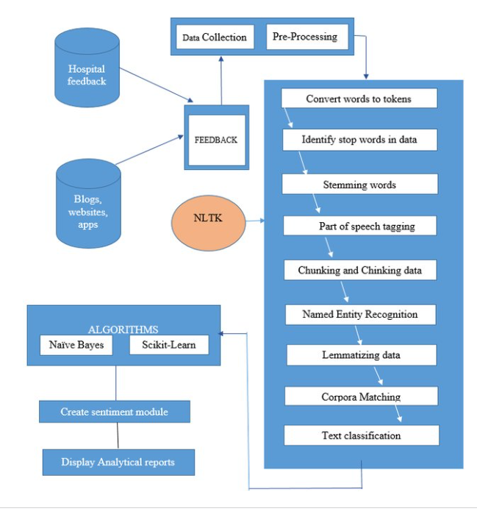
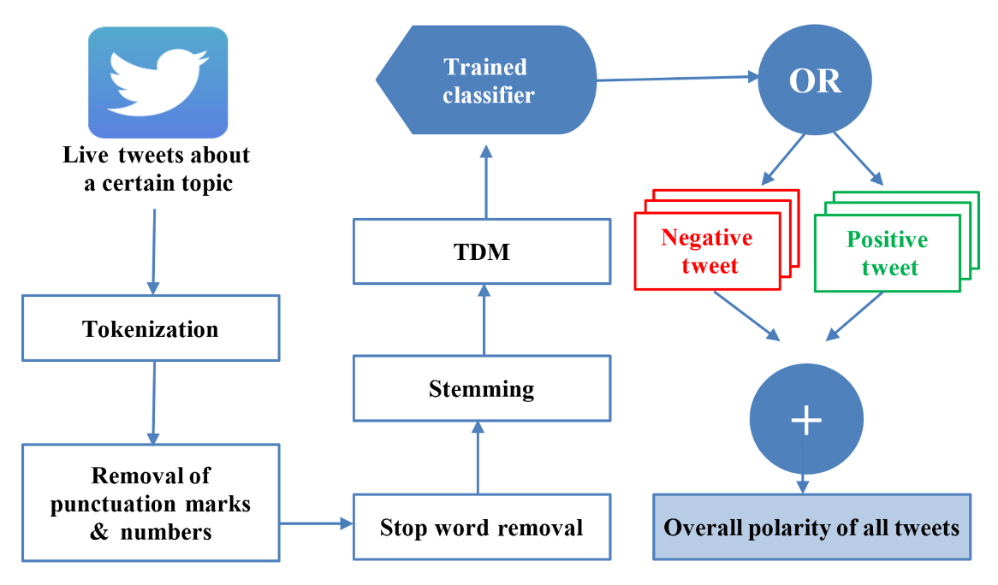
Sentiment Analysis Flow-Chart
General Flow-Chart
Example

Slide 54
Example of NLP & its Explanation
Step 1: Text Preprocessing
The goal is to prepare the text for analysis by removing unnecessary parts and focusing on key elements.
Tokenization:
Split the sentence into individual words (tokens).
Tokens: ["The", "movie", "was", "fantastic", "but", "the", "ending", "was", "disappointing"]
Stop Word Removal:
Remove commonly used words like "the", "was", "but", etc., as they don't contribute significantly to the sentiment.
After removing stop words: ["movie", "fantastic", "ending", "disappointing"]
Result of Preprocessing:
The focus is now on the important words: "movie", "fantastic", "ending", "disappointing".

Slide 55
Explanation Continue
Step 2: Sentiment Analysis Model
Now, we analyse the sentiment based on the processed text.
Word-Level Sentiment Scoring:
Each important word is assigned a sentiment score based on the model’s trained knowledge:
"fantastic" → Strongly Positive (+2.0)
"disappointing" → Strongly Negative (-1.5)
Combining Sentiments:
Add up the scores for the words:
Positive score: "fantastic" → +2.0
Negative score: "disappointing" → -1.5
Net score = +2.0 - 1.5 = +0.5 (positive sentiment dominates).

Slide 56
Explanation Continue
3. Context Analysis:
The word "but" indicates a contrast. It suggests the negative sentiment ("disappointing") applies only to the ending, not the entire movie.
The positive word "fantastic" strongly impacts the overall sentiment because it describes the movie as a whole.
4. Classification:
The sentiment analysis model uses a threshold to classify the overall sentiment:
If the score is above 0, it’s positive.
If the score is below 0, it’s negative.
Since the net score is +0.5, the sentence is classified as positive.

Slide 57

Why is it Positive?
The positive sentiment ("fantastic") about the movie as a whole outweighs the negative sentiment ("disappointing") about the ending.
Words like "fantastic" carry a stronger weight in sentiment analysis, especially when they refer to the broader context of the sentence (the movie overall).

Slide 58
Key Applications of NLP
Machine Translation (e.g., Google Translate).
Virtual Assistants (e.g., Alexa, Siri).
Sentiment Analysis (e.g., product reviews).
Information Retrieval (e.g., search engines).
Text Summarization (e.g., summarizing articles).

Slide 59
Challenges in NLP
Ambiguity
Example: "He saw the man with the telescope" (Who has the telescope?).
Context Understanding
Example: "Bank" (Riverbank vs. Financial bank).
Multilingual Texts
Processing multiple languages effectively.
Noisy Data
Slang, typos, and informal text.

